Slide 1

Implementing AWS for Salary Analysis
Group 8: Jupiter Kang, Crystal Kao, Alonso Romero

Slide 2
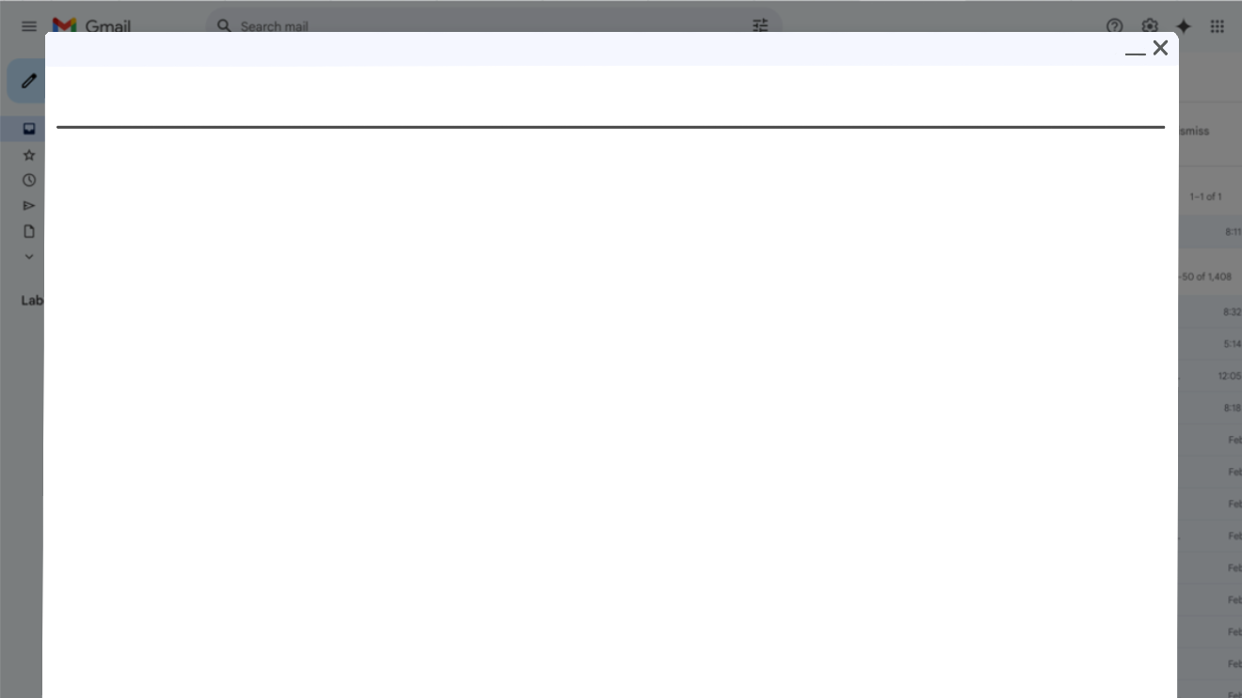
Scope of Project
Objective: Compare salaries of job listings based on if AWS is listed as a requirement in the description to see if knowing AWS pays more than jobs without AWS in the description
Compared to all data science job listings in 2017 on Glassdoor
Goal: Create a dashboard in QuickSight to visualize our findings

Slide 3


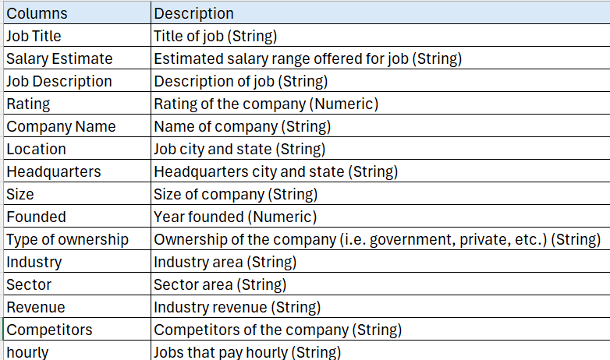
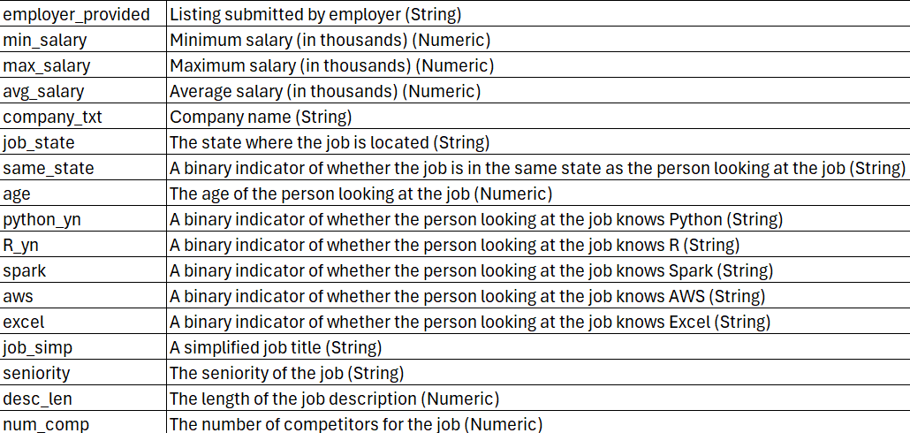
Data Source and Features
2017-2018 data: https://www.kaggle.com/datasets/thedevastator/jobs-dataset-from-glassdoor/data
32 columns, 742 rows

Slide 4

Features to Implement
S3 Bucket
Store data in buckets
Create static website to display findings in one place
VPC
Create internet gateways, subnets, and routing tables for EC2 instances
EC2
Create instances from computing sources in the cloud
Run a Jupyter Notebook or Python file to preprocess data
IAM
Control access to S3 bucket, QuickSight
Define IAM roles with specific permissions for different jobs
Set up billing alert and monitoring budgets
QuickSight
Connect with data from S3 bucket to create dashboards
Create histogram to show the distribution of salaries

Slide 5
Project Architecture
S3
Website
Kaggle Dataset
Raw Data
QuickSight
IAM
VPC
Public Subnet
Private Subnet
EC2
EC2
Python File

Slide 6
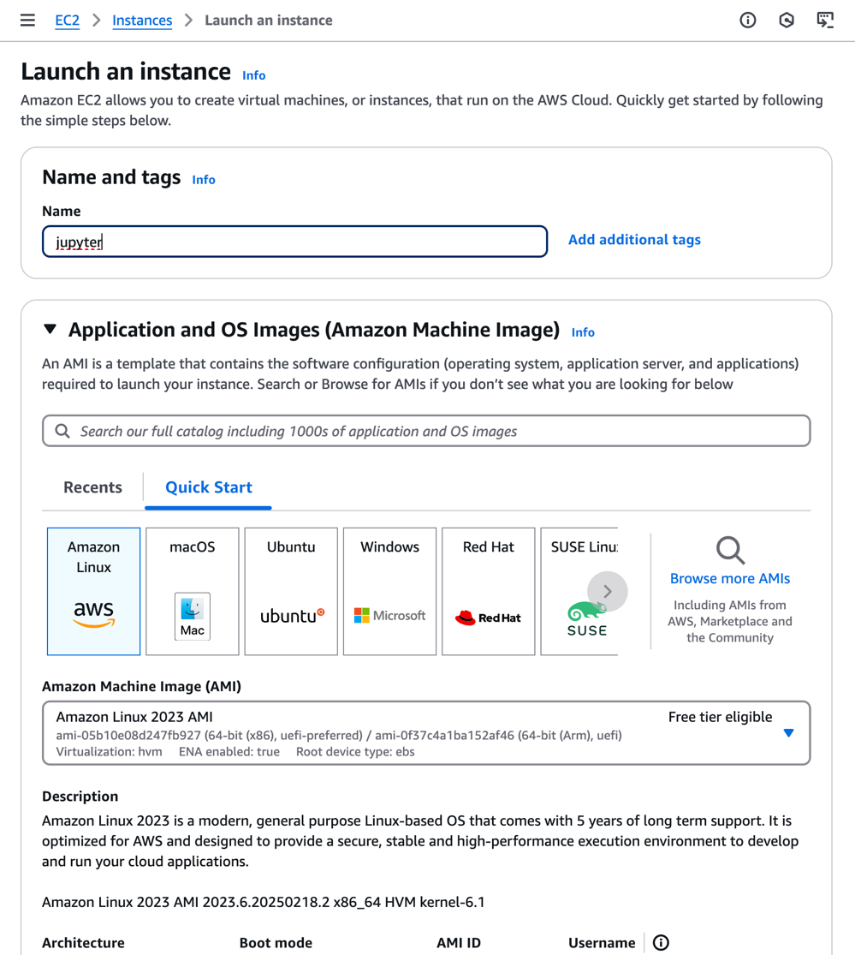
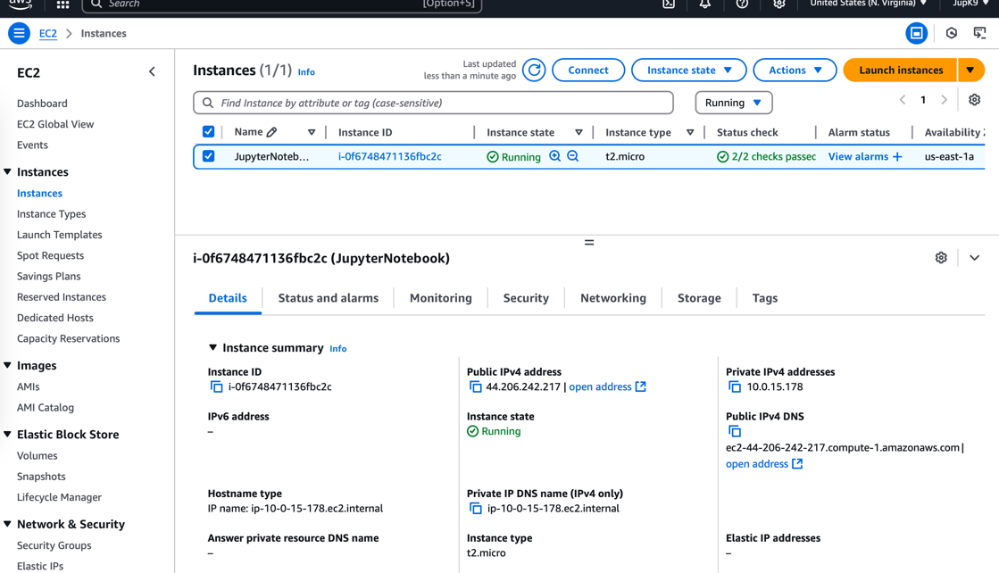
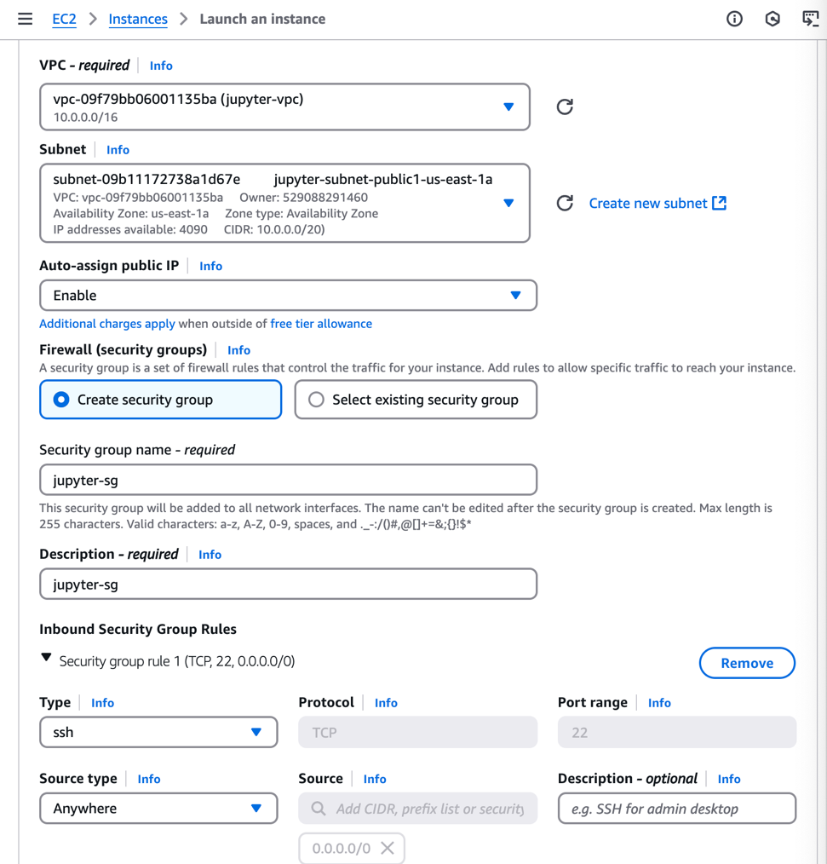
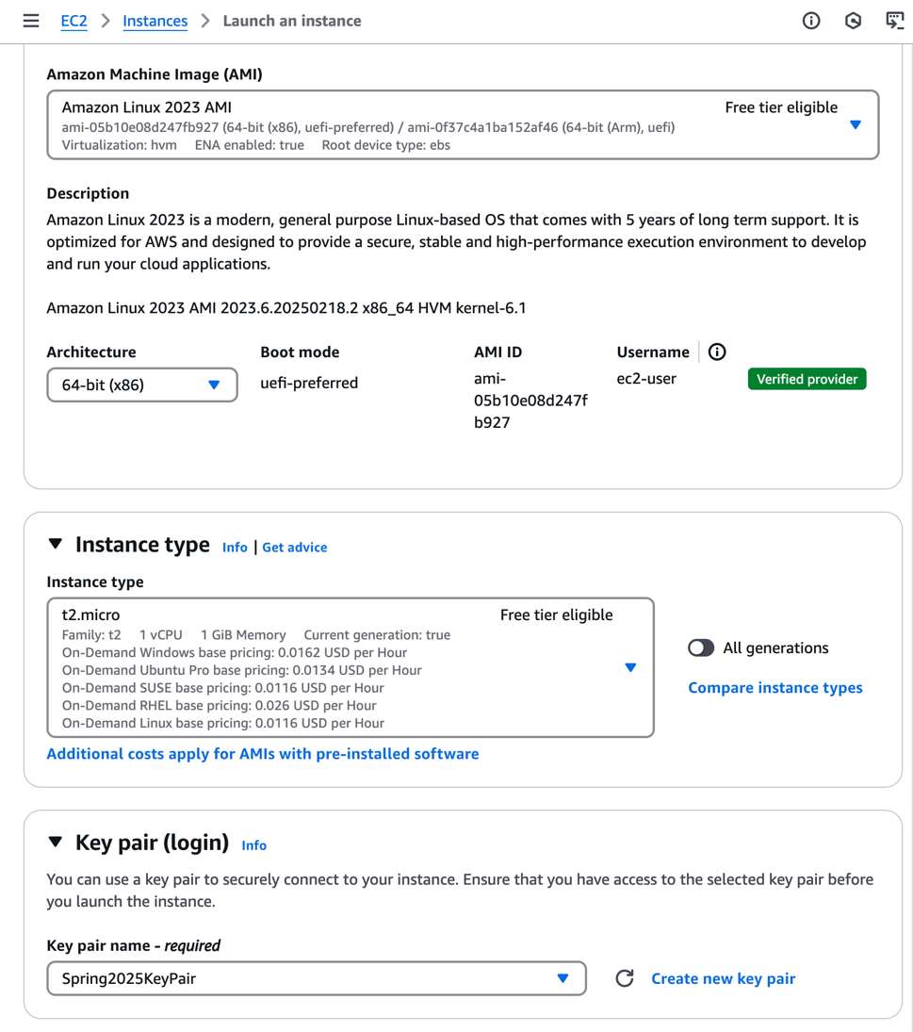
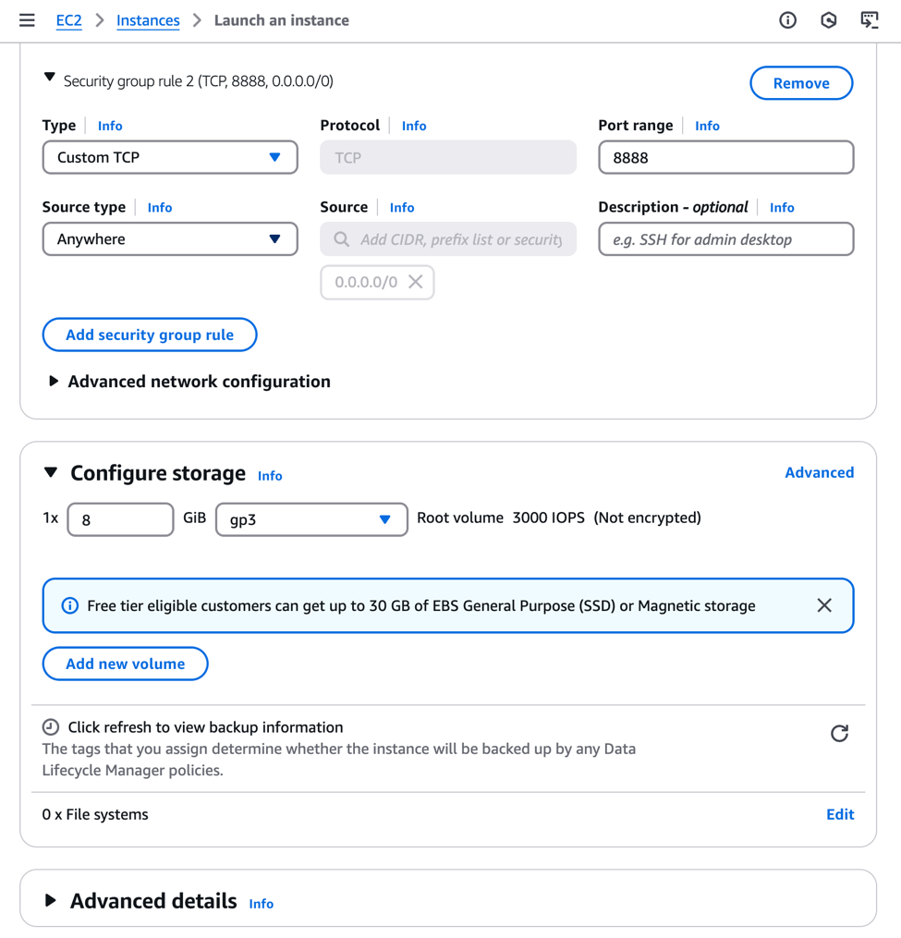
VPC creation

Slide 7
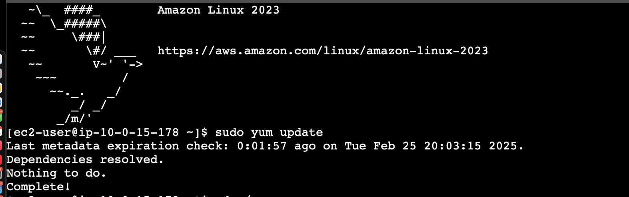
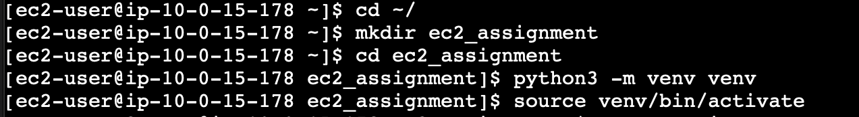
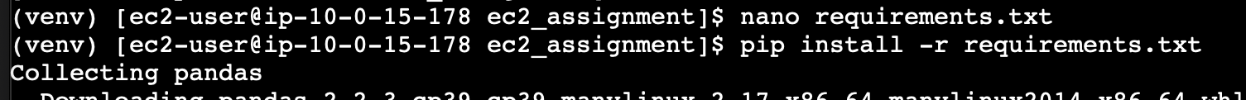
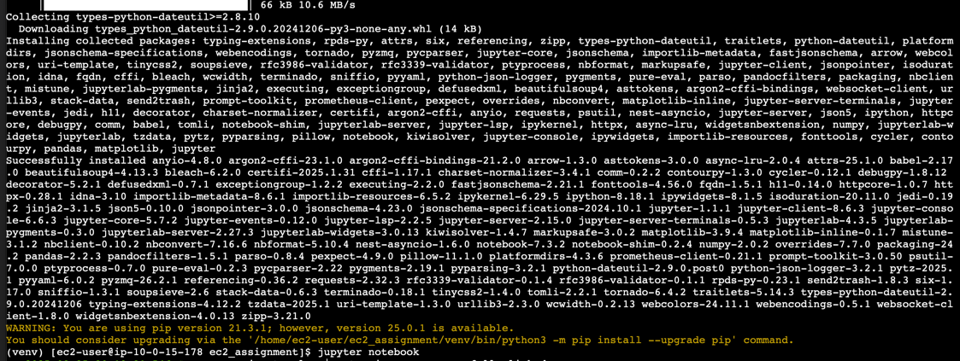

Slide 8
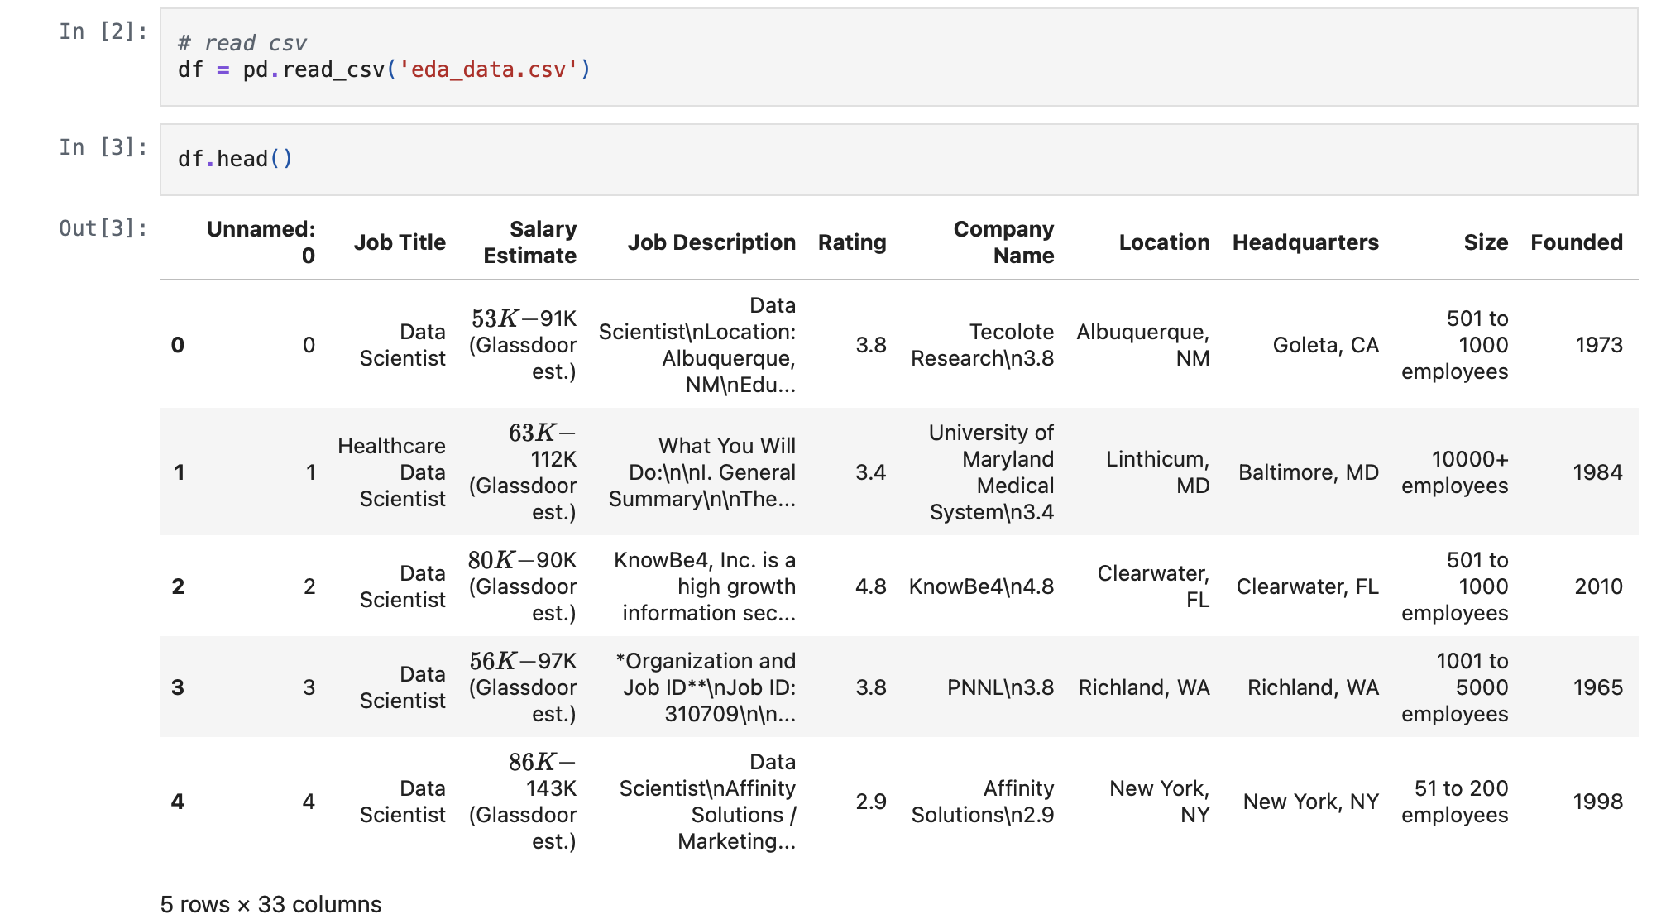

Slide 9
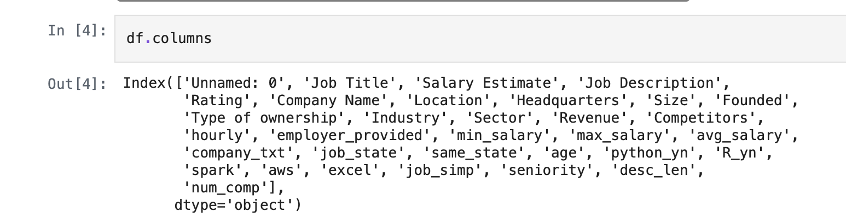

Slide 10
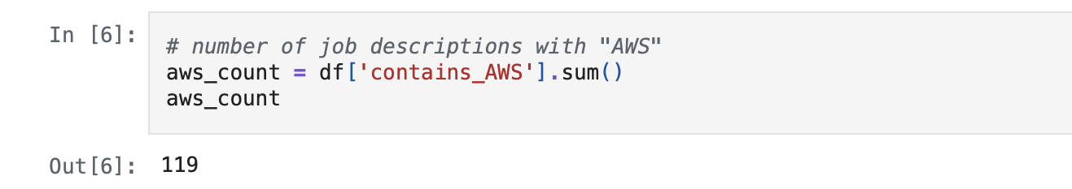

Slide 11
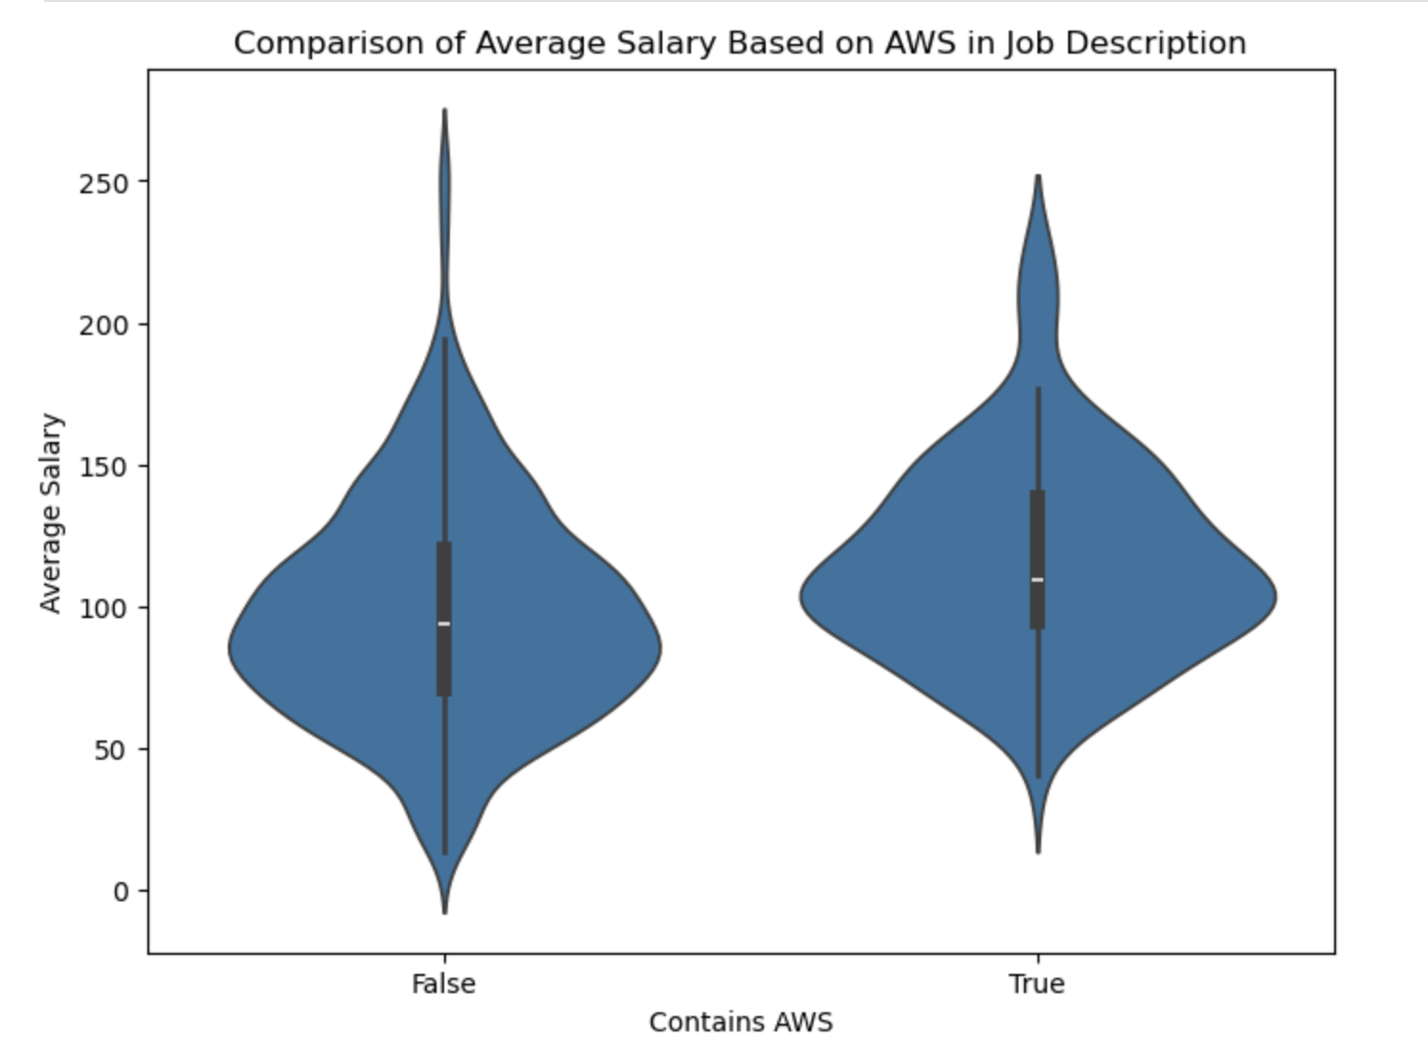

Slide 12
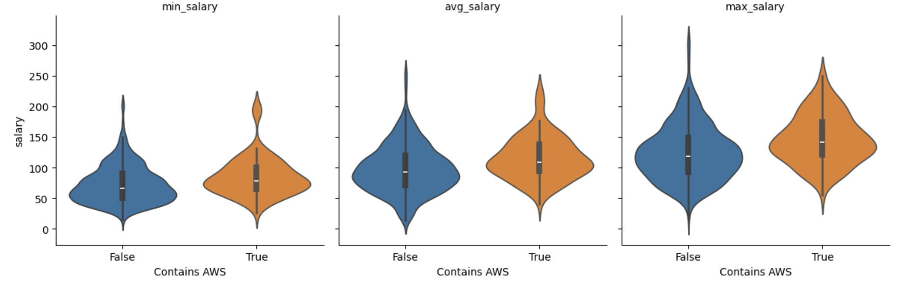
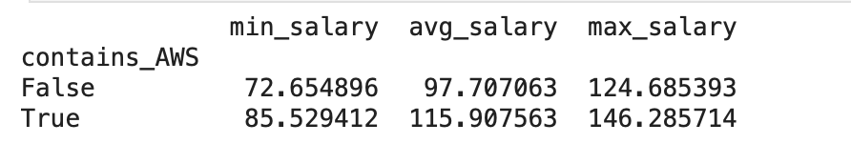

Slide 13
Dashboard Recording

Slide 14
Conclusions
Hypothesis: Jobs that require AWS skill tend to have a higher pay than jobs that don’t
Conclusion: Yes, jobs that require AWS skill tends to have a higher pay than jobs that don’t
Factors for consideration on salary differences:
Cost of living (Location)
Company type (Type of Ownership - government, private, etc.)
Industry/sector (Industry or Sector)
Experience level (Seniority)
Contains AWS | Min Salary | Avg. Salary | Max Salary
True | $86K | $116K | $146K
False | $73K | $98K | $125K

